Slide 1
Anomaly Detection in Microservices Cloud application: Benchmark & Scenarios Course on Graph Neural Networks (Summer Term 22)
Prof. Dr. Holger Giese (holger.giese@hpi.uni-potsdam.de)
Christian Medeiros Adriano (christian.adriano@hpi.de) - “Chris”
Matthias Barkowski (matthias.barkowski@hpi.de )
Iqra Zafar (iqra.zafar@hpi.de)

Slide 2
Microservices architecture (Intro)

Slide 3
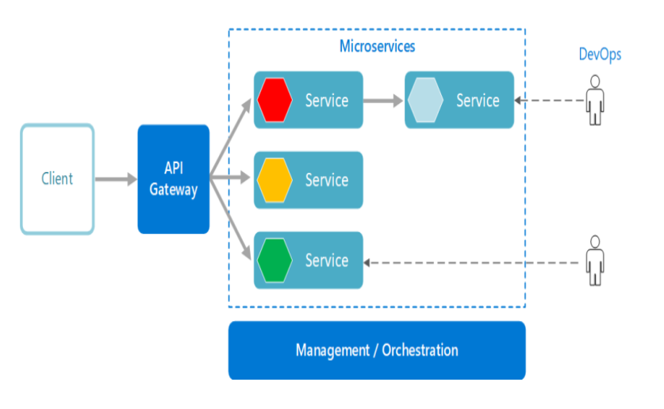
Microservices architecture
Architectural style emerging out of Service-Oriented Architecture (SOA)
Distributed applications are broken up into small independently deployable services.
Each service running in its own process and communicating via lightweight mechanisms
Speed up the development process
Kubernetes
https://www.leanix.net/en/wiki/vsm/microservices-architecture

Slide 4
Open Challenges
Refactoring,
Localizing the sources of anomalies
Dynamic application structure
Indirect anomaly propagation
Multiple types of metric (Latency, Throughput, CPU load, RAM, Disk I/O, Power, Availability )
This highly dynamic environment aggravates the difficulty
in detecting anomaly and its root cause localization

Slide 5
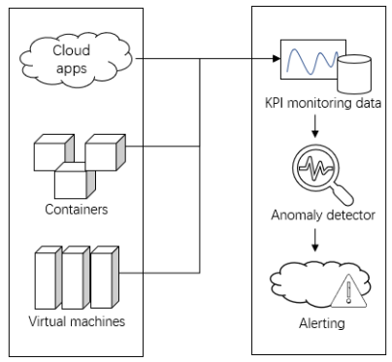
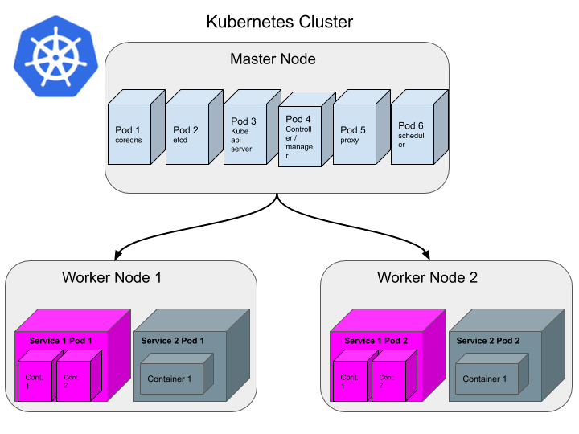

Process Overview
Microservices
Cloud Environment
Outlier Detector
https://kubernetes.io/

Slide 6
Anomaly detection Scenarios and Benchmark application

Slide 7
Anomaly Detection Scenarios
Resource Exhaustion
Exhaust CPU
Container Pause
hangup of a service instance
Exhaust memory
High load of requests
Excessive Client’s request
Inject anomaly
Microservices
Cloud Environment
Outlier Detector

Slide 8

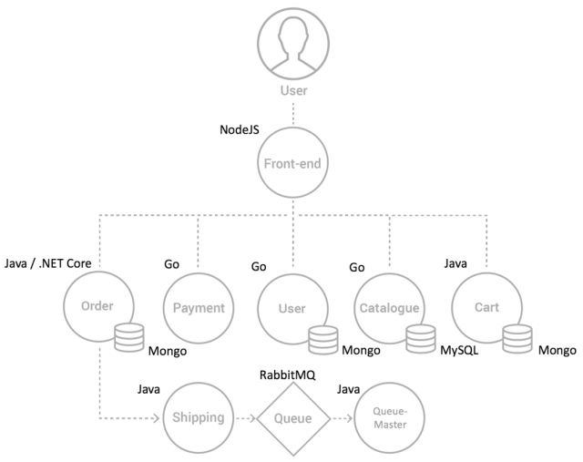
Microservices-Benchmark application
https://microservices-demo.github.io/
Sock Shop architecture

Slide 9
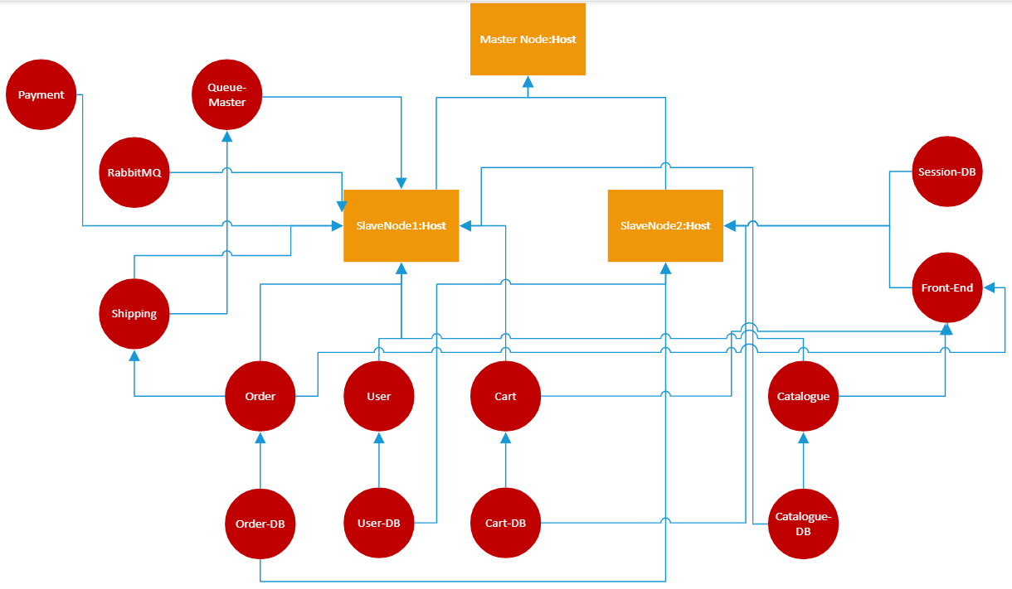
Sockshop embedded in Kubernetes cluster
Host {CPU:75% , memory:75% , …}
RT
Container {CPU, memory, …}
RT
RT
RT
Response Time: RT
RT
RT
RT
RT

Slide 10
Dataset

Slide 11

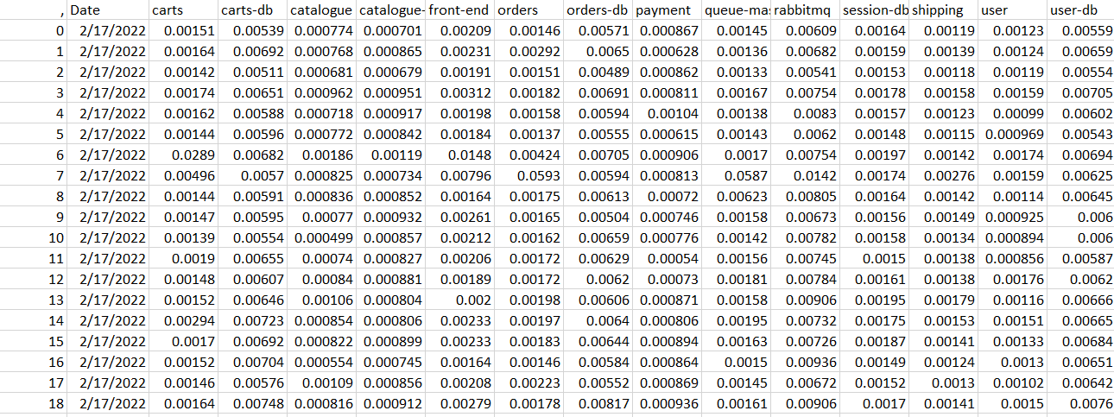

Monitored Dataset
Monitored Nodes: all services involved in under-monitoring system (carts,catalogue,front-end,orders,payment,queue-master,rabbitmq,session-db,shipping,user,user-db)
Features: CPU Usage, Memory Usage
Data Set:
Training set (Normal) used for calibration
Test set (Abnormal)
CPU Usage of Order service
timestamp
2/17/2022 10:30:30
2/17/2022 10:30:40
For every 10 sec

Slide 12
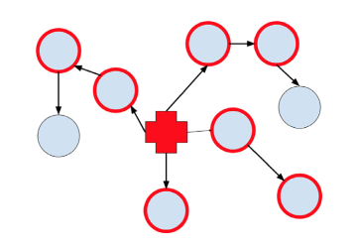
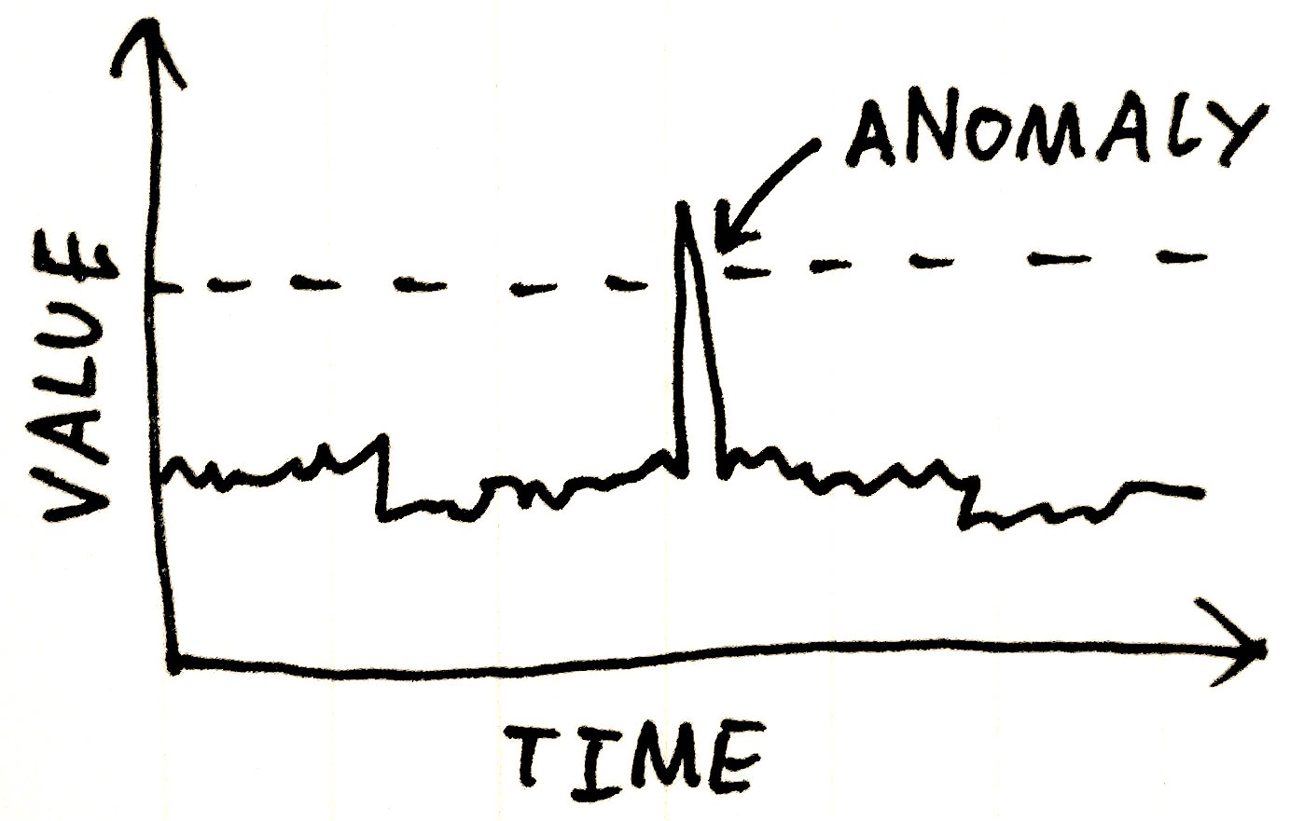
Comparison btw Time-Series vs Graph based Anomaly Detection
Time-Series anomaly Detection
Anomaly detection involves identifying the differences, deviations, and exceptions from the norm in a dataset
Approach: Extreme value Theory
Graph-based anomaly Detection
analyze connectivity patterns in communication networks and identify suspicious behaviors
Approach: Attributed graph model
Hooi, Bryan. Anomaly detection in graphs and time series: Algorithms and applications. Diss. Army Research Laboratory, 2019.

Slide 13
WP-1 – Anomaly Detection
Anomaly Detection using (Extreme Value Theory-EVT)-> Find out anomalous KPI
Granger Causality test -> capture correlation among time series data
-> help to determine anomaly propagation (WP-2)
Related Work
1- Ji, Suozhao, Wenjun Wu, and Yanjun Pu. "Multi-indicators prediction in microservice using Granger causality test and Attention LSTM." 2020 IEEE World Congress on Services (SERVICES). IEEE, 2020.
2- Li Wu, Johan Tordsson, Erik Elmroth, Odej Kao. Causal Inference Techniques for Microservice Performance Diagnosis: Evaluation and Guiding Recommendations. ACSOS 2021
3-Wang, Qing, et al. "Detecting Causal Structure on Cloud Application Microservices Using Granger Causality Models." 2021 IEEE 14th International Conference on Cloud Computing (CLOUD). IEEE, 2021.
4-Siffer, Alban, et al. "Anomaly detection in streams with extreme value theory." Proceedings of the 23rd ACM SIGKDD International Conference on Knowledge Discovery and Data Mining. 2017.

Slide 14
END

